Slide 1
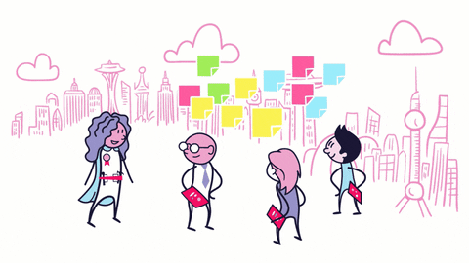


Women Development Programs with Google
Hosted By
Janani Thesu Vasudevan
Vijayalakshmi Bhakthavachalam

Slide 2

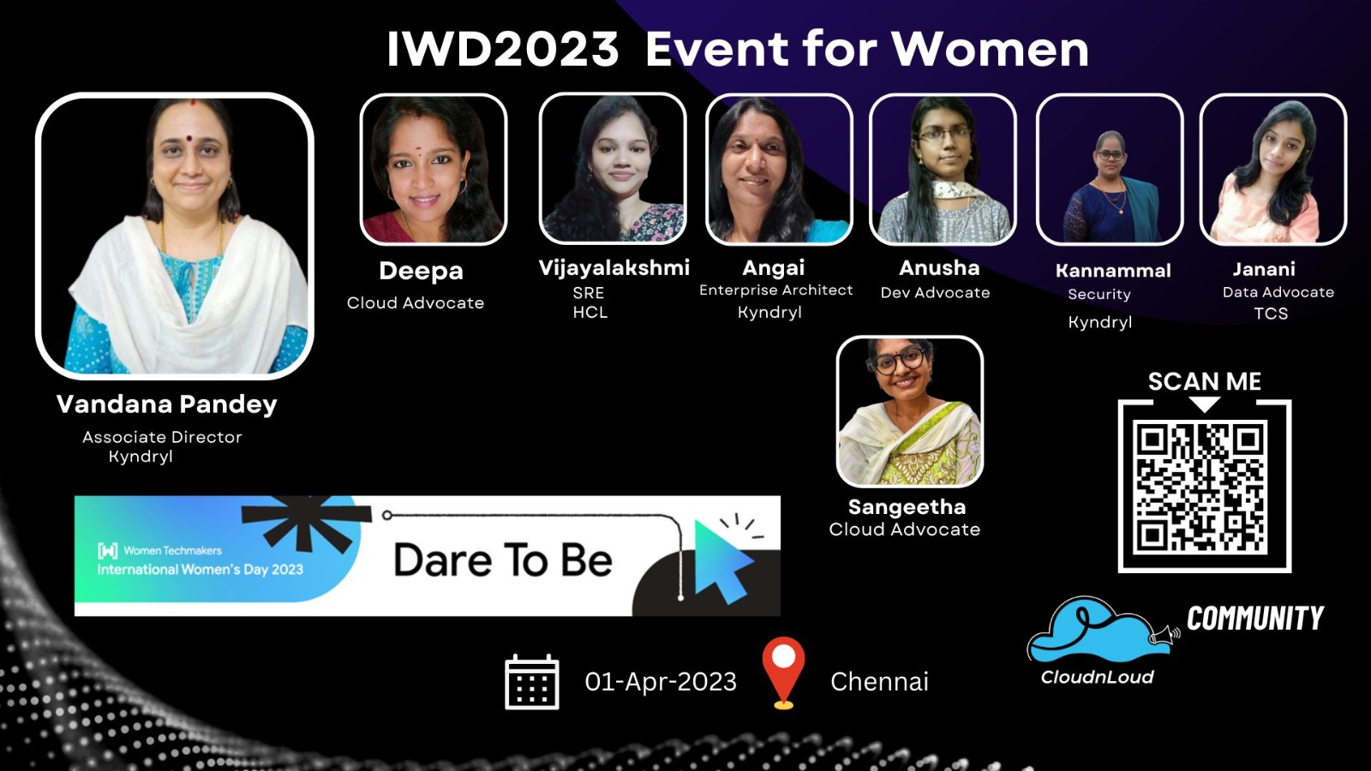
Women Tech Maker Program
POWER OF COMMUNITY
Technical Community
Benefits being an active participants in Community
How can you get involved in Technical Community
Need of community for your Growth
Thanks Giving for Women

Slide 3







Technical Community
Power Of We..! CloudnLoud Tech Community!
VISIBILITY

Slide 4
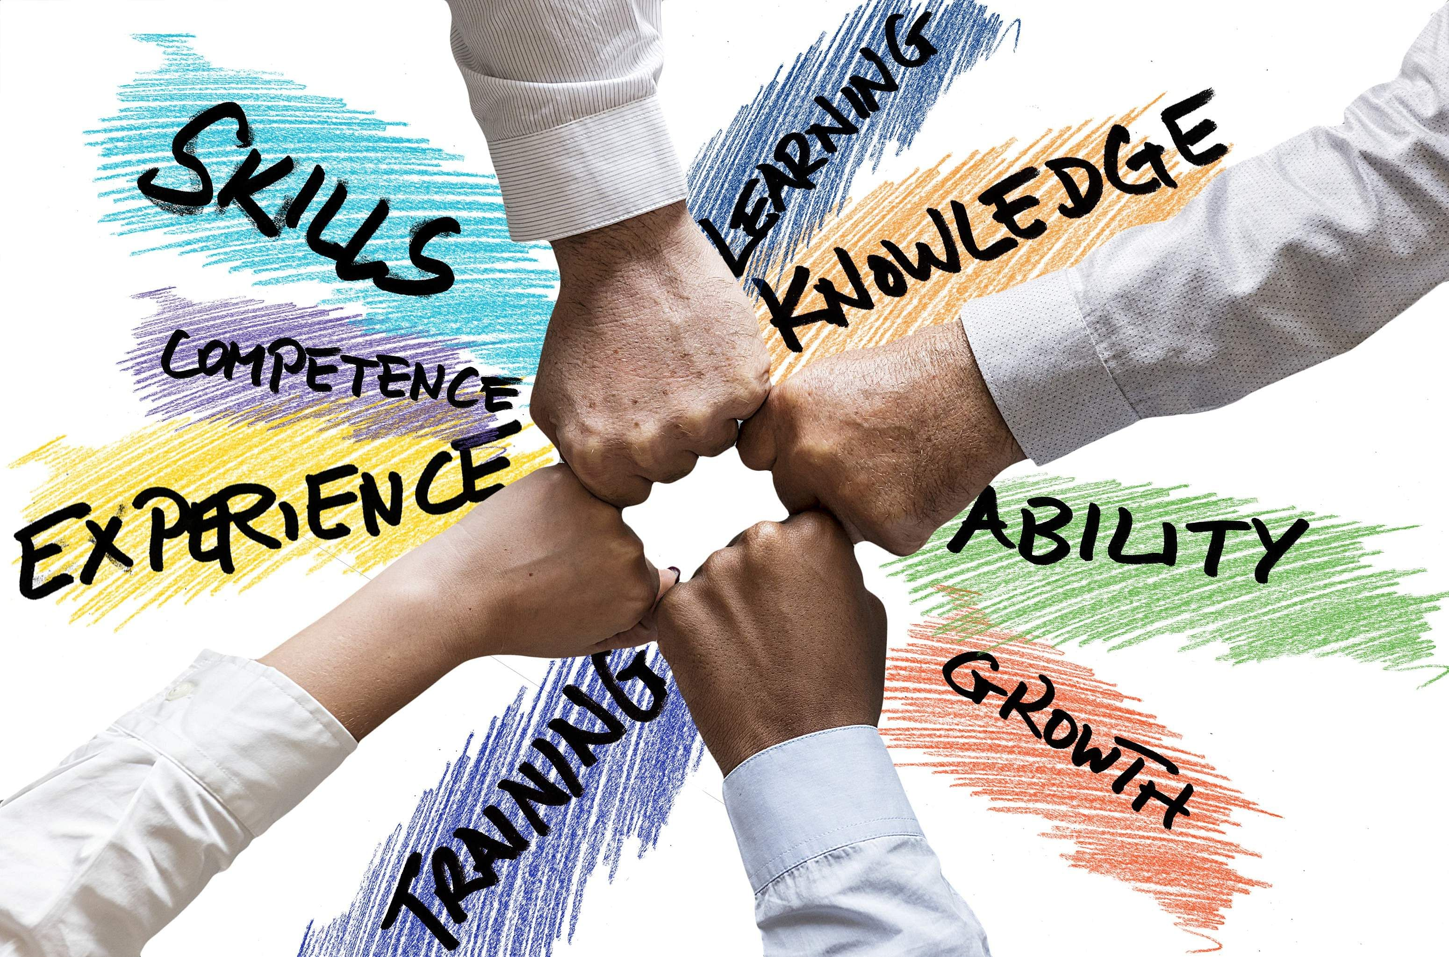

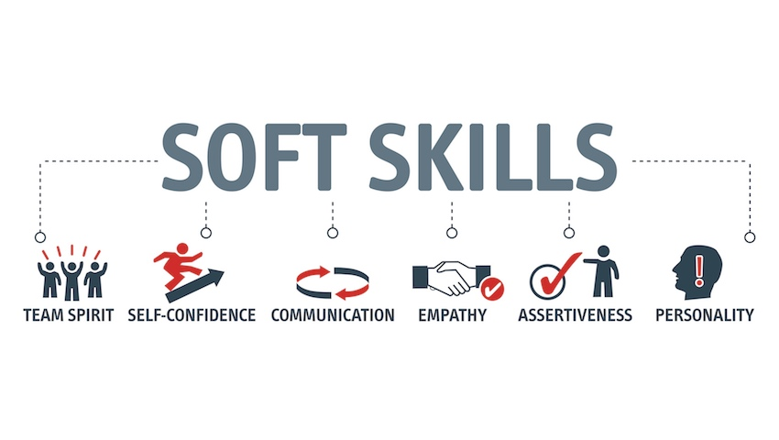
Benefits Being an Active Participant in Community
Together we Grow

Slide 5

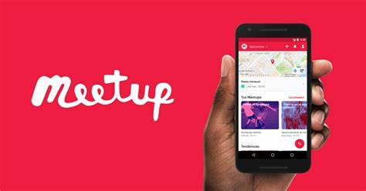


How can one get involved in Community
Want to get involved in Community?💡
Who can involve in community? 💡
Any Aspirants
Students
Mothers
Tech Lovers
Contributor
Mentors
Any individual with Growth Mindset

Slide 6

Community Purpose
We are here to help!!
How to explore yourself in Community
Try Fail Grow
Be an active participant
Share your Learnings within team
Explore new Technologies along with experts
Look for speaker Opportunity
Go for tech meetups
Keep upgrading yourself with use cases

Slide 7

Thanks Giving for Women
This is one of my FAVORITE days of the year because it allows us the incredible opportunity to highlight the women
Recently, I learned very quickly just how valuable my circle of support is.
Thank you for being a total LADY BOSS because it shows me it’s OK to be one as well.

Slide 8


THANK YOU

